Slide 1
BIAS & OVERFITTING

Slide 2
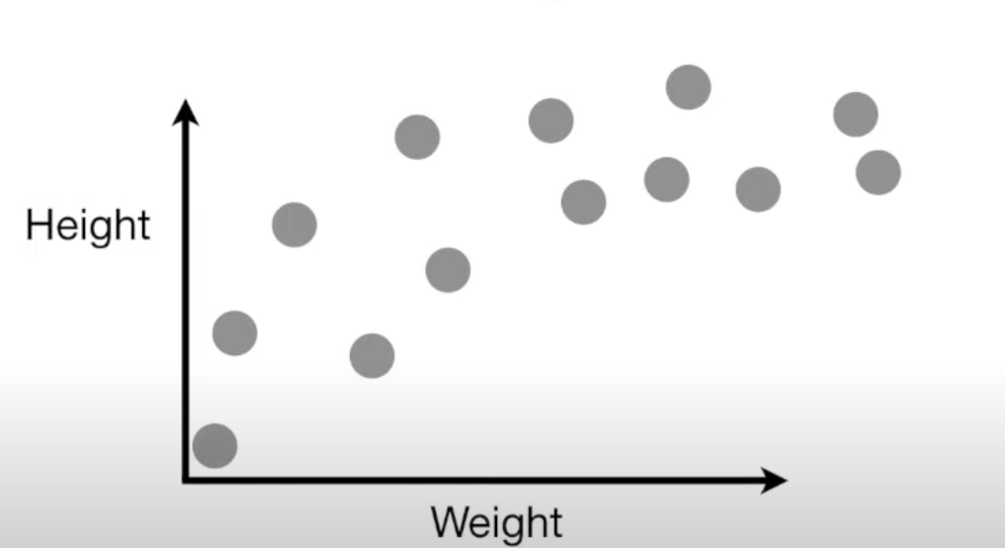
Imagine
Imagine we measured the weight and height of a bunch of mice and plotted the data on the graph

Slide 3
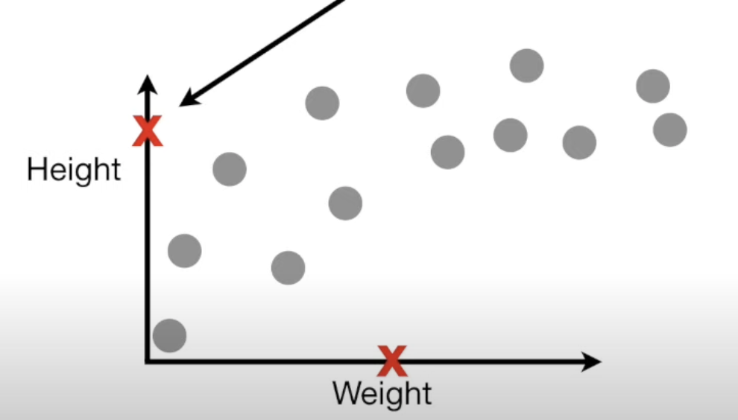
If weight is known we want to predict the height

Slide 4
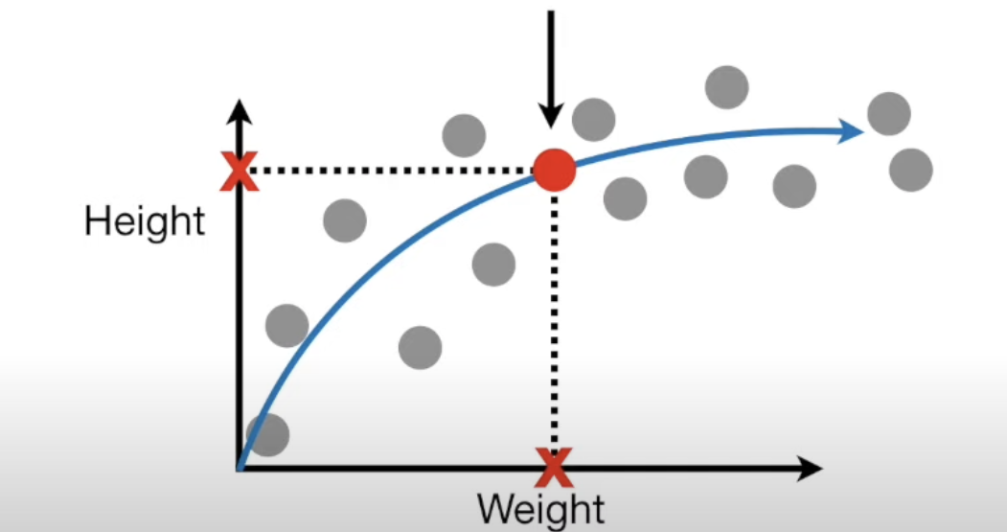
Ideally, we would know the exact matehmatical formula that
describes the relationship between weight and height

Slide 5
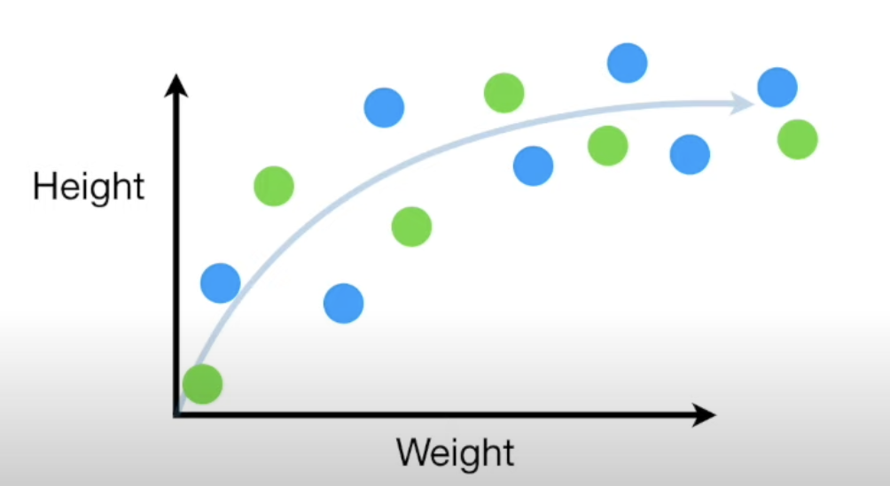
We will use two models to predict it. First the done is dividing
data into training (blue) and testing (green) data

Slide 6
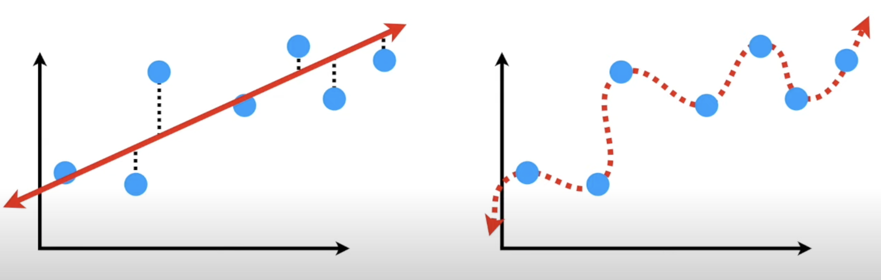
Straight Line has more BIAS and Squiggly line has very little BIAS
Notes:
Regression fits a staright to model it. But straigjt line does not have the flexibility to replicate the arc in the ‘true’ relationship. No matter how we try to fit the line it will never fit. The inability for this algorithm to capture the true realtionship is called BIAS. It has large amount of BIAS.
Another method might fit a swiggly line to the training set. Its super flexible and hugs the training set along the arc of the true relationship. It has very little BIAS.

Slide 7
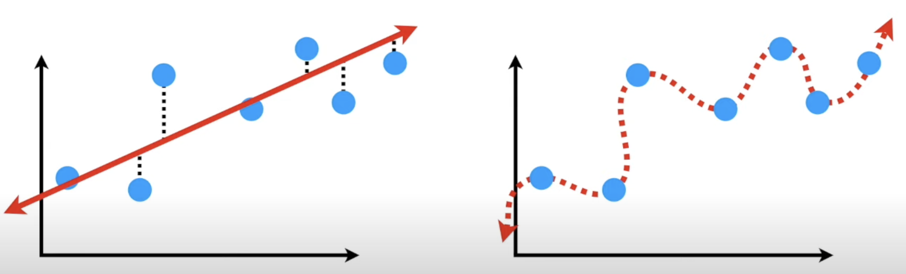
We can compare how well the STRAIGHT LINE and the Squiggly LINE fit the training set
by calculationg the sums of squares of distances from training points to the line
Notes:
Swiqqly Line sum of squares of distances is 0 so I wins

Slide 8
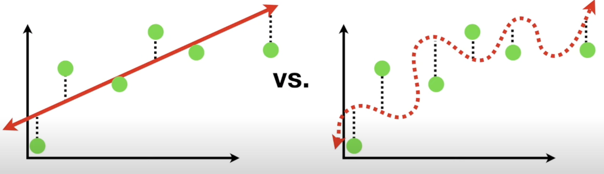
Here straight line wins. The Squiggly lines did a great job for training set but did a terrible job for testing set. Difference in fits in DM is called VARIANCE.
Notes:
Swiggly line has low BIAS, since it is flexible and can adapt to the curve in the relationship between weight and height. But it has high variability because it results in vastly different Sums of Squares for different datasets. Vicerversa for straight line.
Striaght lines might give good prediction but not great but they will be consistencely good predictions.

Slide 9
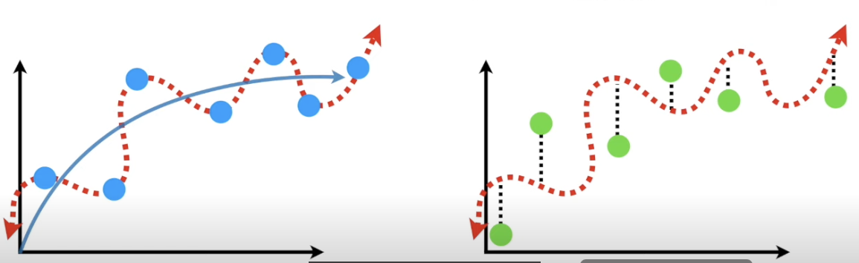
OVERFITTING
Because the Squiggly line fits the training data really well, but not the testing set we say the Squiggly line is OVERFIT

Slide 10
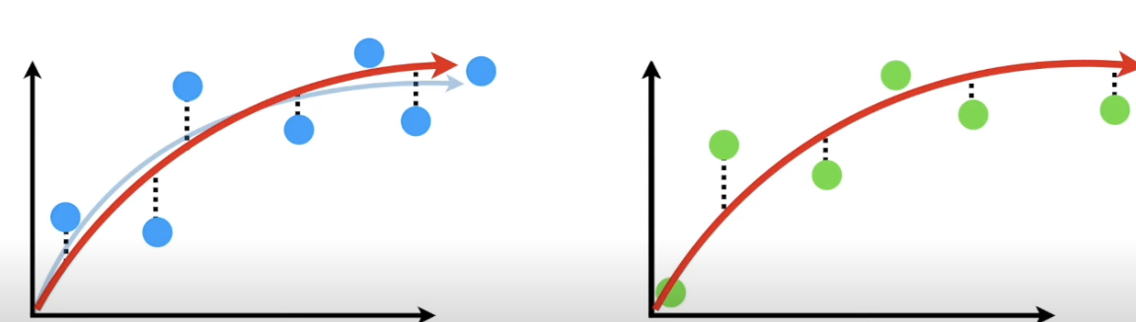
Ideal model should have low BIAS and low variability and should product consistent predictiosn across different datasets.

Slide 11
Bagging and Boosting
To find a good balance of simple and complicated model we perform bagging and boosting

